Slide 1
Tighes Hill 2014
Term 1
Writing Assessment
Years 1-6

Slide 2
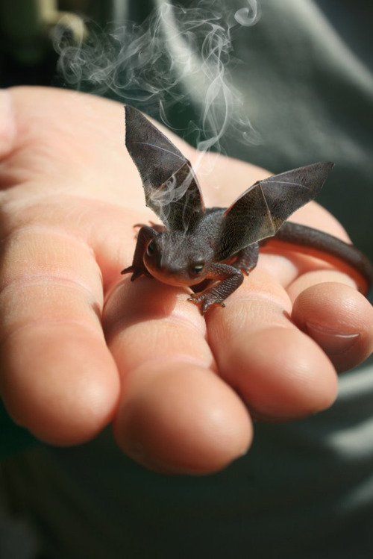
Today you are going to write a narrative or story.
Part of your idea is this person with a tiny dragon in their hands.
Who is the person?
Where did the dragon come from?
What is he/she trying to do?
What happens when the dragon gets bigger?
http://headproduct.tumblr.com/post/18373339828/dragon

Slide 3
Think about:
the characters and where they are
the complication or problem to be solved
how the story will end.
Remember to:
plan your story before you start
write in sentences
pay attention to the words you choose, your spelling and punctuation, and paragraphs
check and edit your writing when you are finished.

