Slide 1
Tighes Hill 2014
Term 3
Writing Assessment
Years 1-6

Slide 2
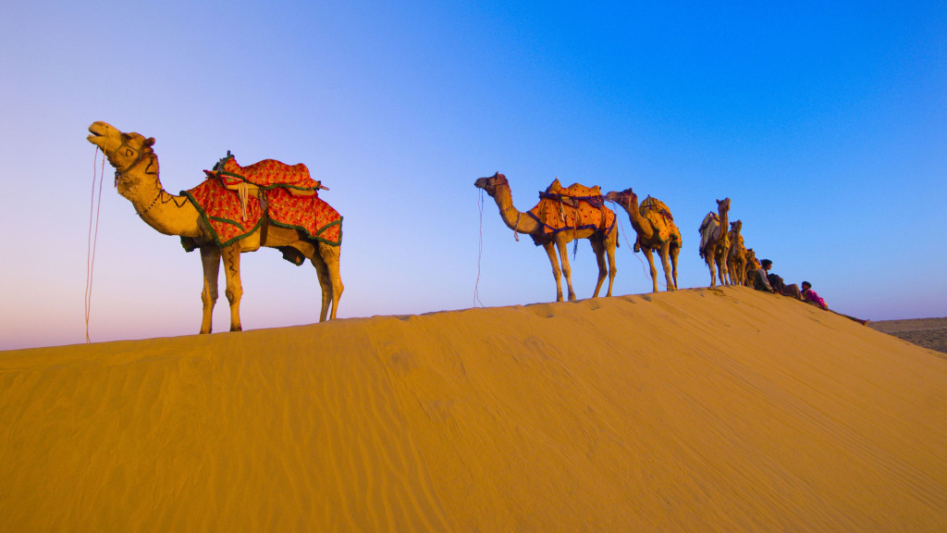
Informative text - Camels
Start with an introduction.
An introduction lets the reader know what you are going to write about.
Write your facts on this topic.
Explain each fact by giving supporting statements. A diagram may help.
Finish with a conclusion.
A conclusion is a way to sum up your writing.
http://wallnen.com/wp-content/uploads/2013/07/Camel-01-HD-Wallpaper.jpg

Slide 3
Informative text - Camels
Remember to:
Plan your story before you start
Write in sentences
Pay attention to the words you choose, your spelling and punctuation, and paragraphs
Check and edit your writing when you are finished.
http://wallnen.com/wp-content/uploads/2013/07/Camel-01-HD-Wallpaper.jpg

