Slide 1
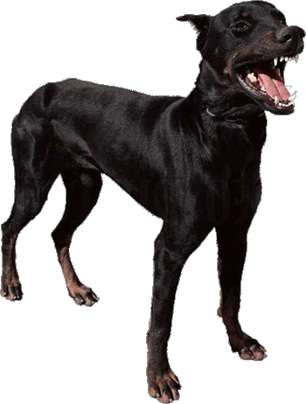
Lesson 1
Using the picture on the left write your best sentence in your Power Writing exercise book

Slide 2
Power Sentence Writing
Learn to write at a Year 5-6 level in only 6 weeks!

Slide 3
Lesson 1
Learning Objective
To understand and apply the 4 rules to writing Power Sentences
Success Criteria
Every student will complete a high quality power sentence by the end of the lesson.

Slide 4
Class Rules
Introducing “CFU”
No hands questioning
Check-in for feedback

Slide 5
APK (Activate Prior Knowledge)
What do you use at the start of a sentence?
A capital letter is used to start a sentence.

Slide 6
APK (Activate Prior Knowledge)
What do you use at the end of a sentence?
A full stop, question mark or exclamation mark is used to end a sentence.

Slide 7
APK (Activate Prior Knowledge)
What is a noun?
A noun is a person, place or thing.

Slide 8
APK (Activate Prior Knowledge)
What is a verb?
A verb is a doing word.

Slide 9
APK (Activate Prior Knowledge)
What is an adjective?
An adjective is a word that describes a noun.

Slide 10
APK (Activate Prior Knowledge)
What is an adverb?
An adverb is a word that describes a verb.

Slide 11
APK (Activate Prior Knowledge)
What is a simile?
A phrase that uses the words like or as to describe someone or something.

Slide 12
CFU
The dog walked towards me.
Identify the noun and write it on your Whiteboard.

Slide 13
CFU
The dog walked towards me.
Identify the verb and write it on your Whiteboard.

Slide 14
Brainstorm
Write an adjective that describes the dog.

Slide 15
Brainstorm
Write an Adverb that describes the way the dog is walking towards you.

Slide 16
The 4 Rules
Apply a time connective (Where appropriate)
Add 1-2 adjectives
Add 1 Adverb
Add a simile (Extension)

Slide 17
The Learning Process
I do
We do
You do

Slide 18
I do
The dog walked towards me.
Step 1: Add a time connective
It was a cold winter afternoon, the dog walked towards me.

Slide 19
I do
It was a cold winter afternoon, the dog walked towards me.
Step 2: Add 1-2 Adjectives
It was a cold winter afternoon, the big, menacing dog walked towards me.

Slide 20
I do
It was a cold winter afternoon, the big, menacing, dog walked towards me.
Step 3: Add an Adverb
It was a cold winter afternoon, the big, menacing dog walked slowly towards me.

Slide 21
I do
It was a cold winter afternoon, the big, menacing dog walked slowly towards me.
Step 4: Add a simile
It was a cold winter afternoon, the big, menacing dog walked slowly towards me like a puma hunting his prey.

Slide 22
Check-in
The dog walked towards me.
It was a cold winter afternoon, the big, menacing dog walked slowly towards me like a puma hunting his prey.

Slide 23
We do
The dog walked towards me.
Rules
Add a time connective
Add 1-2 Adjectives
Add 1 adverb
Add a simile

Slide 24
You do
The dog walked towards me.
Rules
Add a time connective
Add 1-2 Adjectives
Add 1 adverb
Add a simile

Slide 25
Plough back
Rules
Add a time connective
Add 1-2 Adjectives
Add 1 adverb
Add a simile

Slide 26
Lesson 1 Check-in
Learning Objective
To understand and apply the 4 rules to writing Power Sentences
Success Criteria
Every student will complete a high quality power sentence by the end of the lesson.

