Slide 1
Mannering Park PS 2014
Term 2
Writing Pre-Assessment
Imaginative Text
Years 1-6

Slide 2
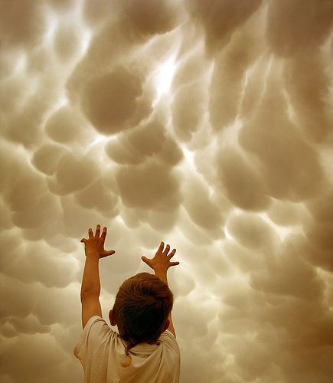
Today you are going to write a narrative or story.
Part of your idea is this child with his hands reaching out into the clouds.
Who is the child?
Why is he/she there?
What is he/she trying to do?
What happens after the child reaches out to the clouds?

Slide 3
Think about:
the characters and where they are
the complication or problem to be solved
how the story will end.
Remember to:
plan your story before you start
write in sentences
pay attention to the words you choose, your spelling and punctuation, and paragraphs
check and edit your writing when you are finished.

